Slide 1
SOC Alert Monitoring & Log Correlation
By: Yash Kasbe

Slide 2
Agenda
Executive Abstract & Goals
Lab Architecture & Investigation Flow
SIEM Platform & Data Collection
Phase 1: SMB Brute Force Detection
Phase 2: Privilege Escalation
Phase 3: Defense Evasion via PowerShell
Phase 4: File Integrity Monitoring (FIM)
Impact Analysis & Tuning Recommendations
Conclusion & References

Slide 3
Abstract & Project Goal
Objective: To design and implement a step-by-step investigation workflow demonstrating how SOC analysts detect and triage suspicious behavior using log correlation.
Methodology: Simulated a targeted attack lifecycle—including SMB brute-forcing, unauthorized user creation, privilege escalation, and defense evasion—and monitored the resulting telemetry.
Final Output: A comprehensive Proof of Concept (PoC) mapping local Windows Security Event logs directly to Wazuh SIEM alerts, concluding with actionable recommendations for rule tuning and reducing SOC alert fatigue.

Slide 4
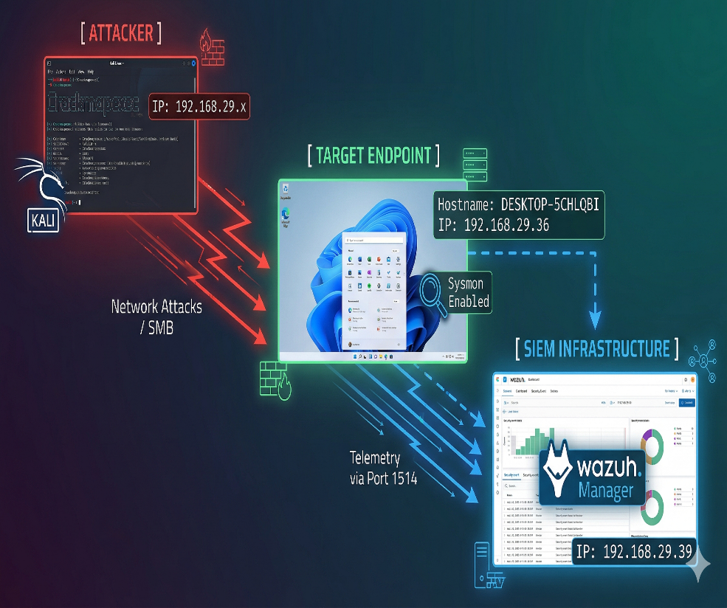
Attack Simulation Environment
To demonstrate the SOC investigation workflow, an isolated lab environment was established:
Attacker Machine: Kali Linux (IP: 192.168.29.x) utilizing tools like crackmapexec to simulate external threat actor behaviors.
Target Endpoint: Windows 11 Desktop (Hostname: DESKTOP-5CHLQBI) configured with advanced security auditing and Sysmon.
SIEM Infrastructure: Wazuh Manager (IP: 192.168.29.39) receiving real-time telemetry from the Wazuh Agent installed on the Windows target.
Lab Environment & Architecture

Slide 5
Investigation Flow
The Kill Chain & Investigation Timeline
Phase 1: Initial Access → Attacker executes SMB Brute Force. SOC Action: Investigate Event 4625 anomalous clusters.
Phase 2: Persistence → Attacker creates rogue hacker account & elevates to Admin. SOC Action: Correlate Event 4720 & 4732.
Phase 3: Evasion → Attacker bypasses PowerShell execution policies. SOC Action: Analyze Event 4688 with bypass flags.
Phase 4: Impact → Attacker manipulates files in C:\Users\admin\Hackers. SOC Action: Review FIM dashboard for integrity changes.
Conclusion → Isolate host, suspend compromised accounts, and tune alerting thresholds.

Slide 6
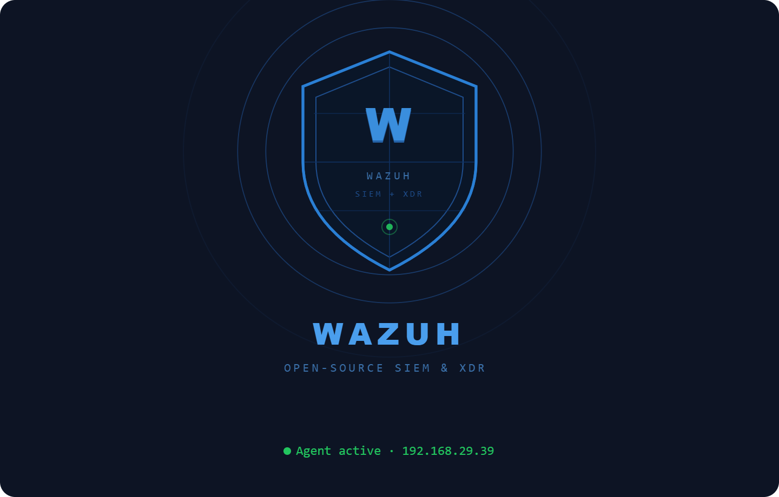
SIEM Selection: Wazuh Deep Dive
Name & Category: Wazuh is an open-source, enterprise-ready Security Information and Event Management (SIEM) and Extended Detection and Response (XDR) platform.
Tool Justification: Wazuh was chosen over alternatives like ELK Stack or Splunk Free due to its open-source flexibility, lightweight agent architecture, and robust out-of-the-box correlation rules.
Popularity: Highly popular in enterprise and academic environments due to its comprehensive MITRE ATT&CK mapping and seamless endpoint telemetry integration.
SIEM Platform Research

Slide 7
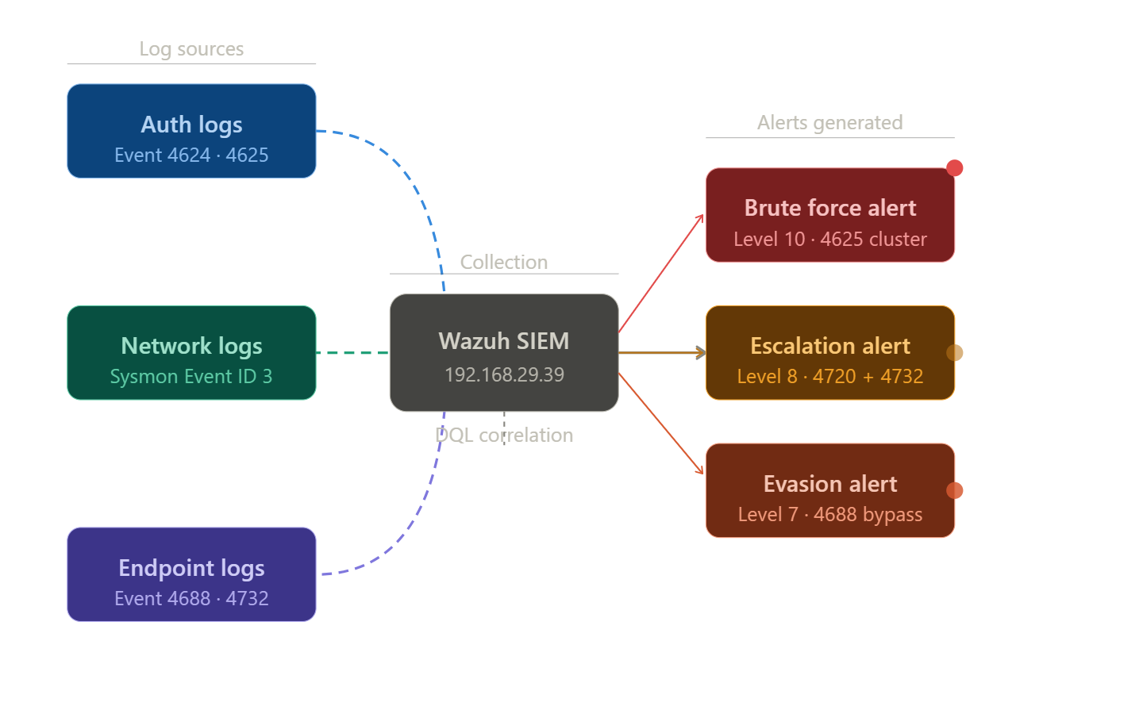
Log Data Collection Strategy
Telemetry, Data Collection & Filtering
To ensure total visibility, the Wazuh agent collected critical endpoint telemetry. Analysts utilized Dashboard Query Language (DQL) filters (e.g., data.win.system.eventID) to isolate the attacker's footprint amidst normal background noise:
Authentication Logs: Auditing Logon events (Success/Failure) to detect brute-force activity.
Network Logs: Monitoring remote SMB connections originating from the attacker subnet utilizing Sysmon Event ID 3 (Network Connections) and native Windows Security logs.
Endpoint/System Logs: Utilizing Windows Advanced Audit Policies to capture Process Creation (Event 4688) and Security Group Management (Event 4732).

Slide 8
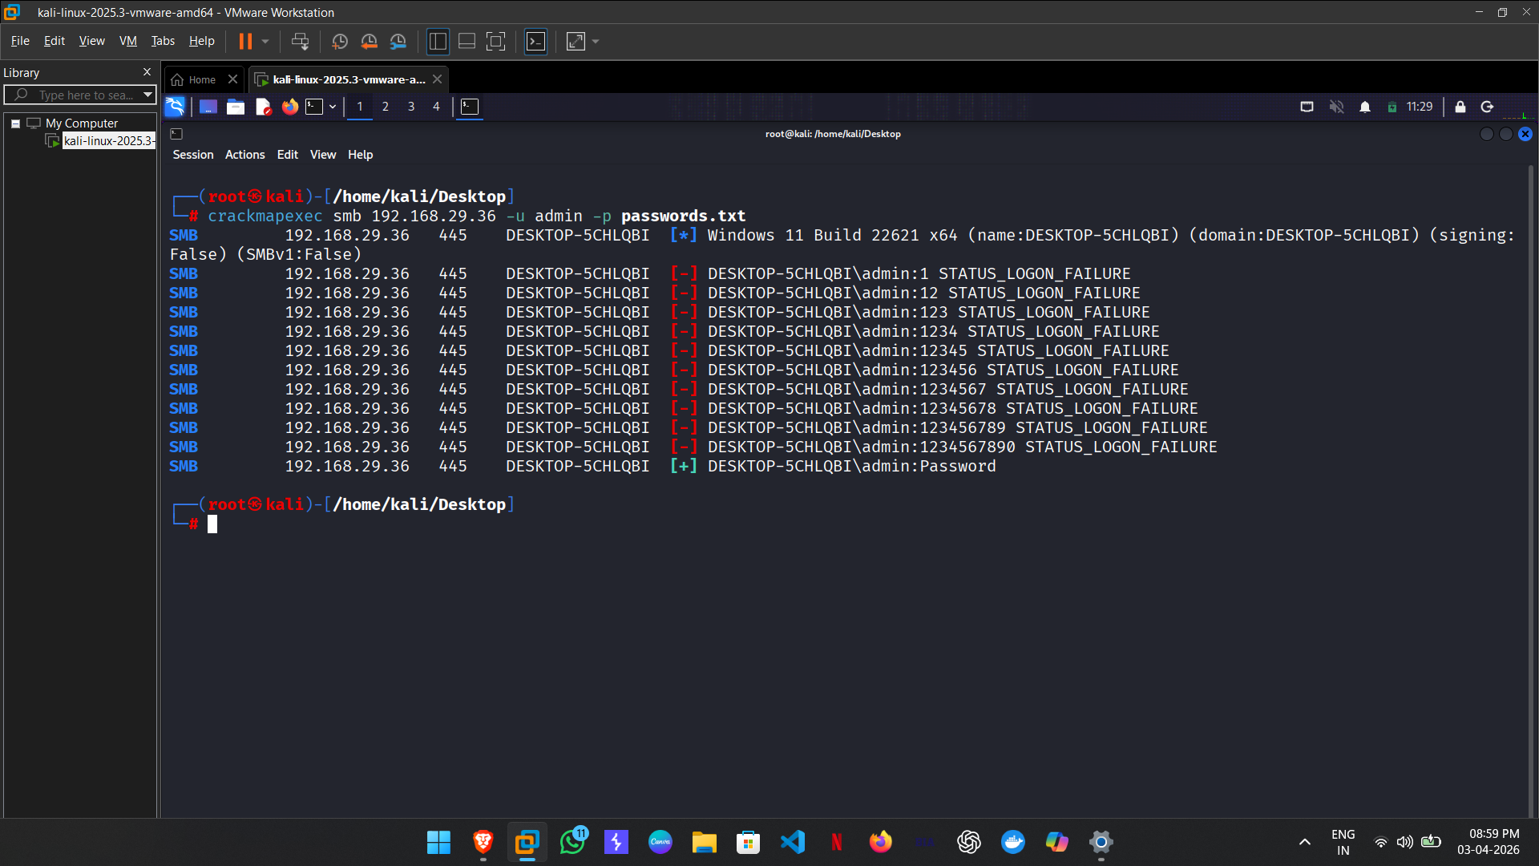
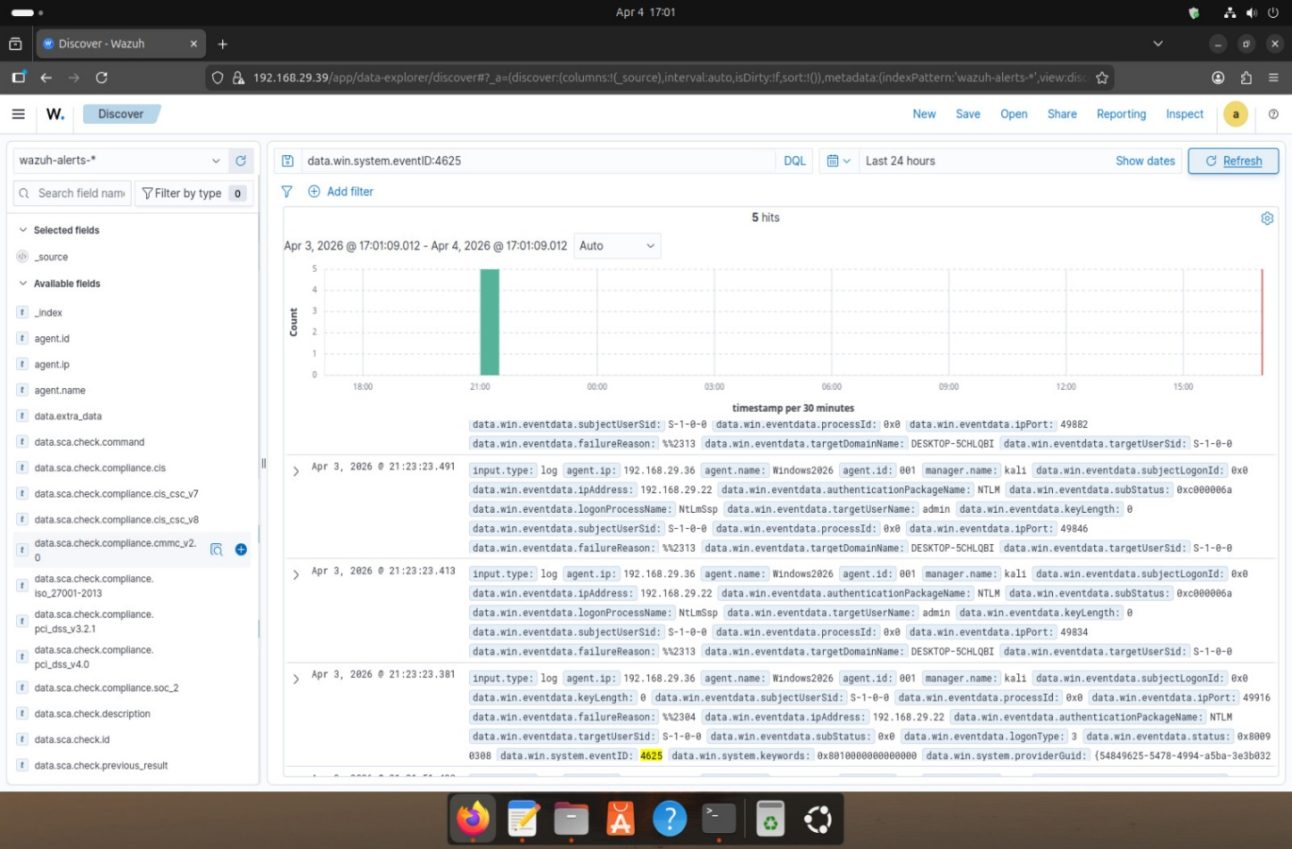
Attack Phase 1: SMB Brute Force Detection
The attack simulation commenced with a dictionary brute-force attack against the endpoint's SMB service using crackmapexec. The SIEM successfully correlated a rapid succession of Event ID 4625 (STATUS_LOGON_FAILURE), immediately followed by a successful authentication (Event ID 4624).

Slide 9
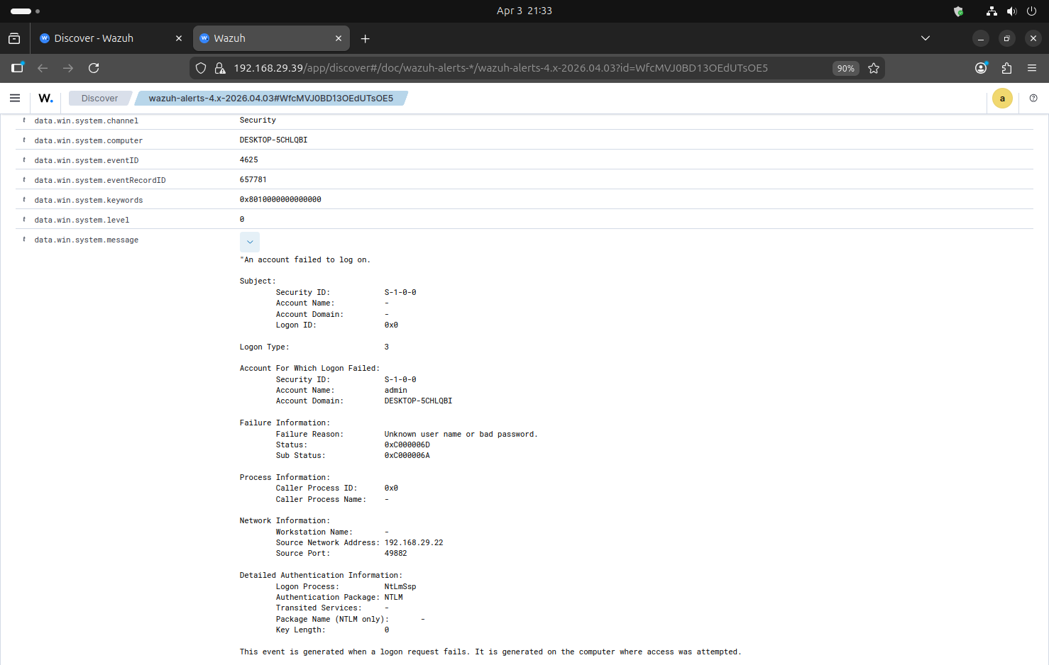
Phase 1 Forensic Evidence: Event ID 4625 Detail
This expanded log identifies the specific targeted account (admin) and the attacker's source IP address (192.168.29.22), providing the forensic link between the brute-force attempt and the Kali machine."

Slide 10
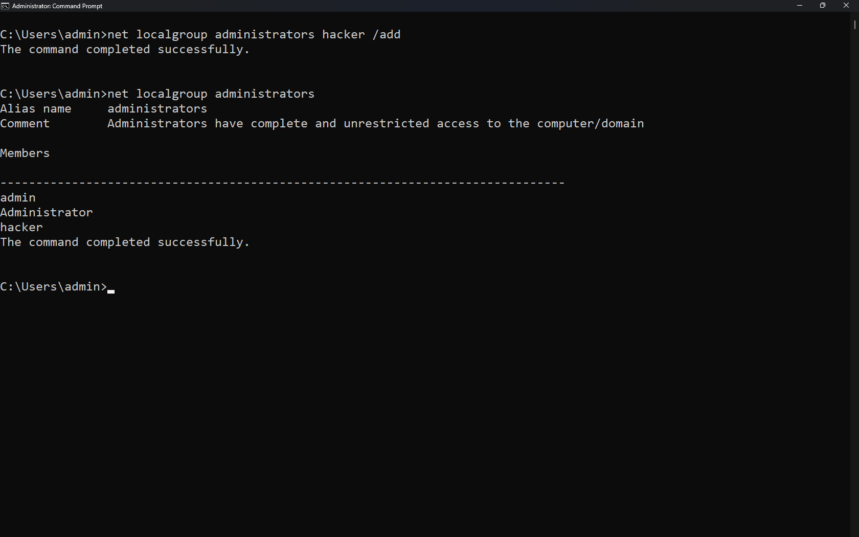
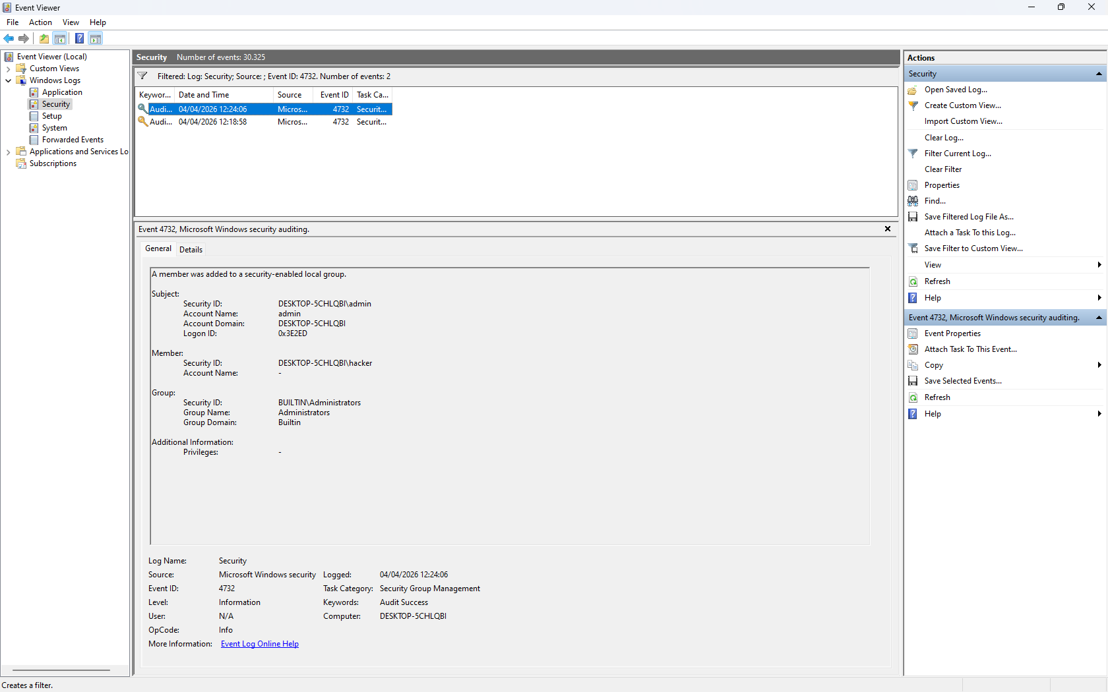
Attack Phase 2: Privilege Escalation & Persistence
After gaining a foothold, the attacker successfully escalated privileges to create a rogue user (hacker) (Event ID 4720) and added it to the local Administrators group. The SIEM captured Event ID 4732, triggering a critical severity alert for unauthorized privilege escalation.

Slide 11
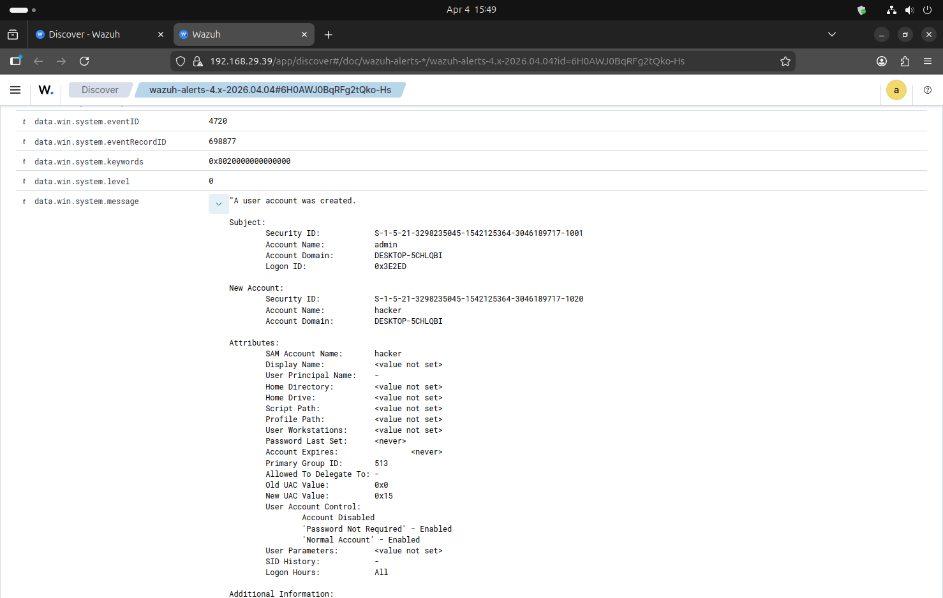
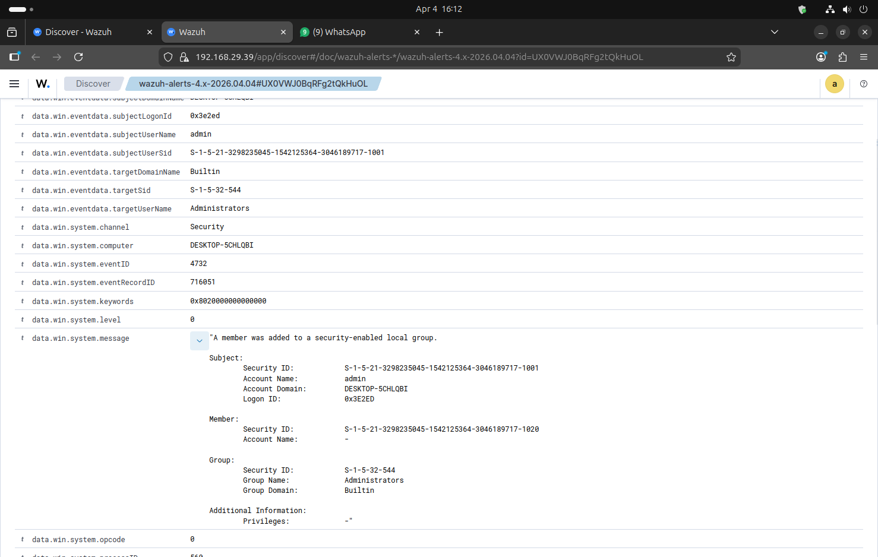
SIEM Correlation: Privilege Escalation
The local endpoint events were immediately ingested by Wazuh. The SIEM successfully correlated the creation of the rogue account (Event 4720) and the critical modification of the built-in Administrators group (Event 4732), triggering high-severity alerts.

Slide 12
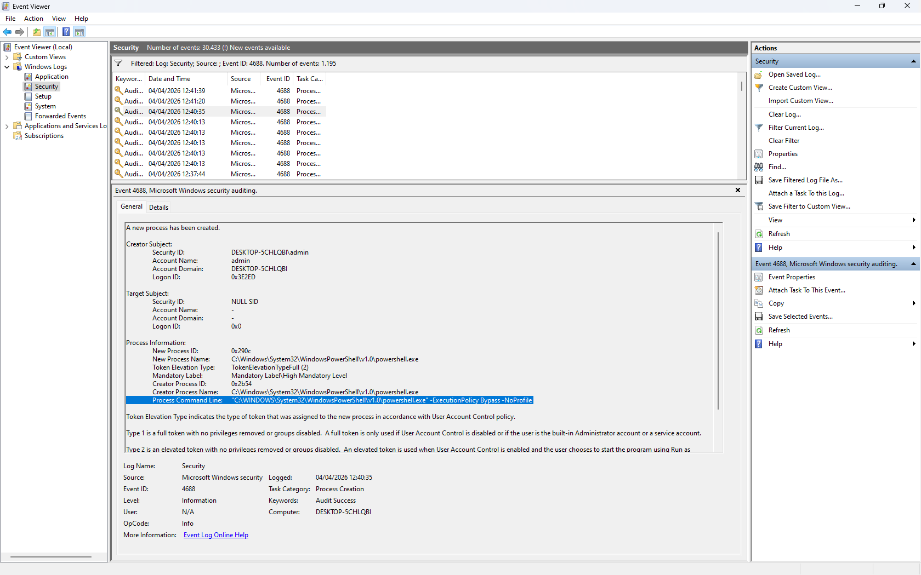
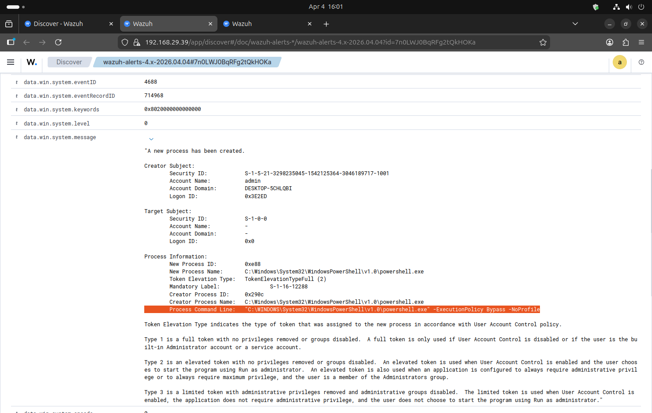
Attack Phase 3: Defense Evasion via PowerShell
To execute payloads without interference from local execution policies, the attacker utilized PowerShell bypass techniques. Command Line Auditing captured Event ID 4688. The SIEM successfully correlated the powershell.exe process with the explicit flags -ExecutionPolicy Bypass -NoProfile.

Slide 13
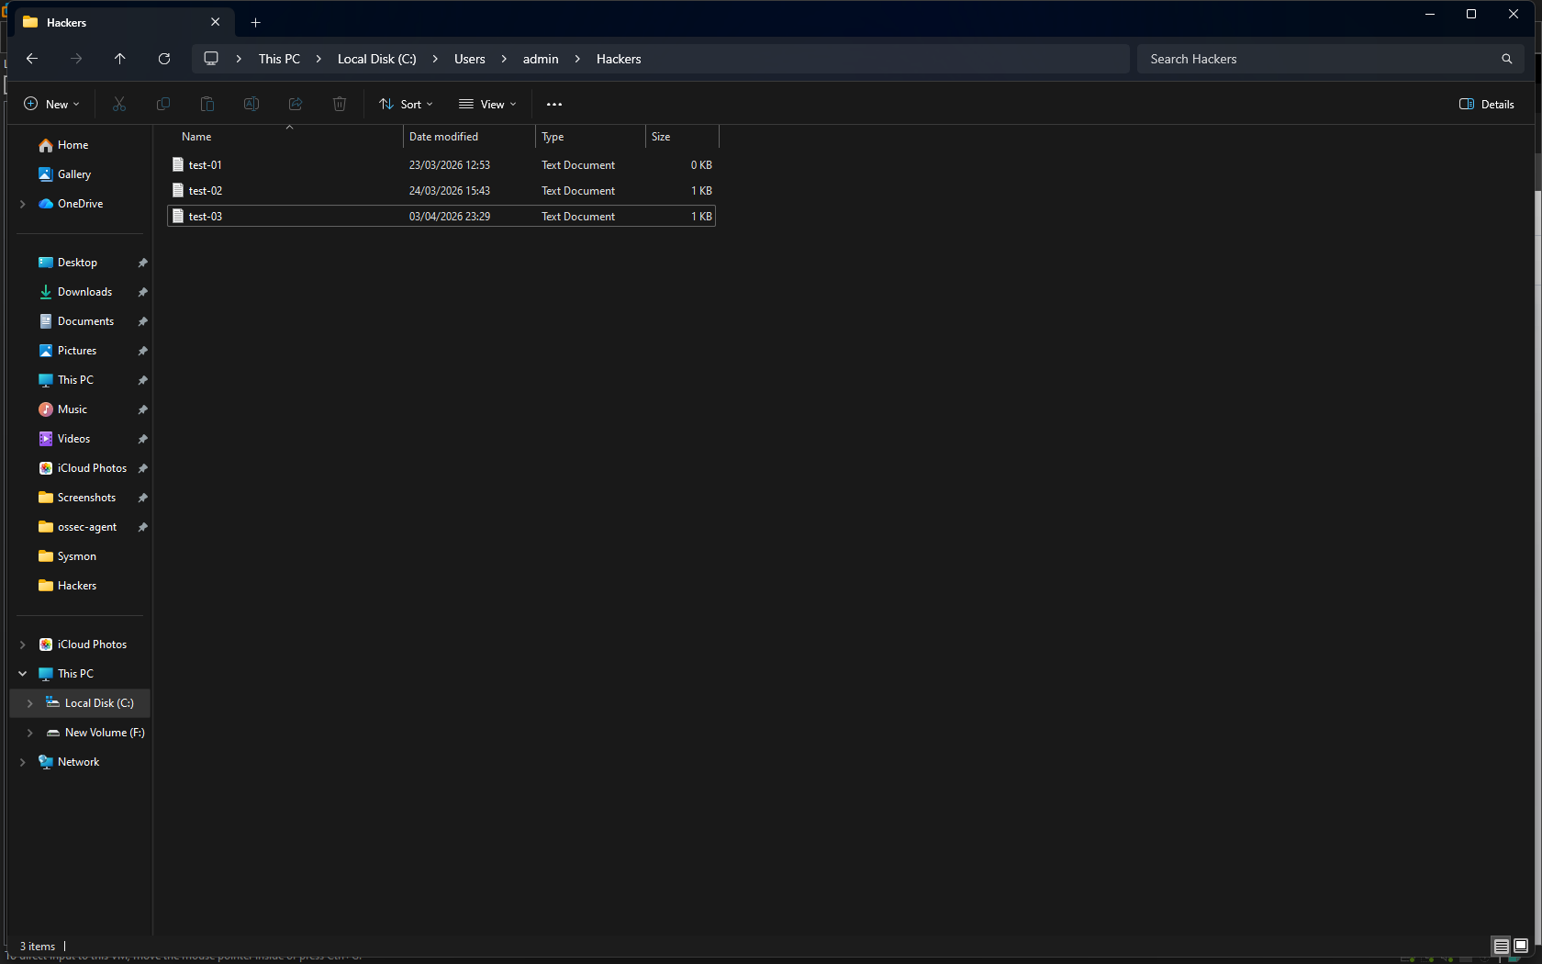
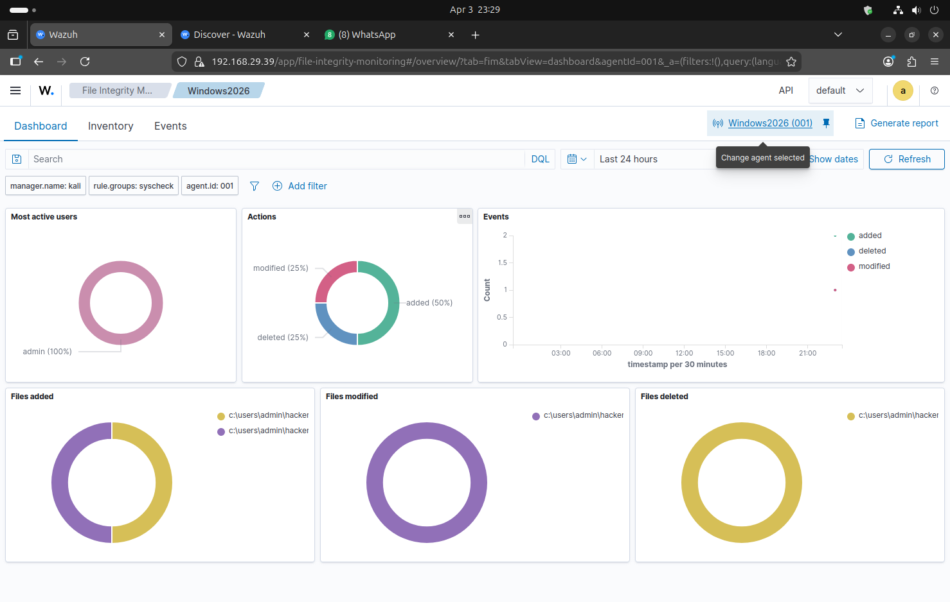
Attack Phase 4: File Integrity Monitoring (FIM)
Wazuh’s File Integrity Monitoring (Syscheck) actively monitored the C:\Users\admin\Hackers directory. The SIEM dashboard provided a correlated timeline of the attacker adding, modifying, and deleting text files, demonstrating the immediate impact on endpoint integrity.

Slide 14
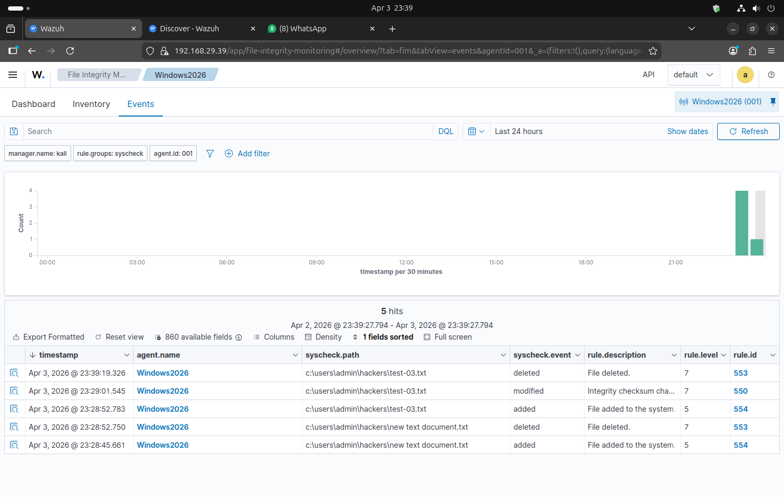
Wazuh successfully captured a detailed timeline of the file manipulations. The SIEM logged the exact timestamps and file paths (e.g., test-03.txt, new text document.txt) for every "added", "modified", and "deleted" action, providing clear forensic evidence of the attacker's impact on the system.

Slide 15
Impact Analysis
Impact Analysis of Alert Correlation
Contextualizing Noise: Raw logs are noisy. An isolated failed logon (4625) has low impact. Correlating multiple failed logons to a subsequent User Creation event (4720) flags a high-impact compromise, prioritizing triage.
Tracing the Kill Chain: By linking network authentication logs to local process creation logs, the SOC can determine the exact scope of the breach and prevent lateral movement.
Reducing Dwell Time: Automated correlation rules reduce the time an attacker resides undetected. Rapid correlation of the Administrator group modification (4732) allows for immediate account suspension before data exfiltration.

Slide 16
Tuning & False Positives
To optimize the SIEM and reduce alert fatigue, the following measures are recommended:
Tuning Brute Force Alerts (4625): Adjust the correlation threshold to trigger only if >15 failures occur within a 3-minute window from the same source IP, filtering out standard typing errors.
Filtering Process Creation (4688): Create child rules that only trigger high-severity alerts when 4688 is accompanied by suspicious arguments (e.g., ep bypass, Hidden) while whitelisting known updater services.
FIM Exclusions: Tune the syscheck rule to ignore highly volatile directories like C:\\Windows\\Temp to prevent dashboard flooding, focusing strictly on critical user directories and registry keys.
Alert Tuning Recommendations

Slide 17
Thoughts & Project Conclusion
Implementing a SIEM is only the first step; the true value of a SOC lies in logical correlation.
By successfully mapping raw, isolated Windows Event logs to a centralized Wazuh dashboard, this project demonstrated how analysts transform raw data into actionable threat intelligence.
Moving forward, continuous tuning of correlation rules (like FIM exclusions and Brute Force thresholds) is critical to maintaining visibility while preventing SOC analyst burnout from false positives.
Conclusion

Slide 18
References
References & Methodology
SIEM Documentation: Wazuh Official Documentation (Log Data Collection, Syscheck).
Log Sourcing: Microsoft Learn - Windows Security Audit Events.
SOC Methodology (MITRE ATT&CK):
T1110: Brute Force (Covers Phase 1: Failed and Successful Logons)
T1136.001: Create Account: Local Account (Covers Phase 2: Persistence)
T1098: Account Manipulation (Covers Phase 2: Privilege Escalation to Admin)
T1059.001: Command and Scripting Interpreter: PowerShell (Covers Phase 3: Execution)
T1562.001: Impair Defenses: Disable or Modify Tools (Covers Phase 3: Defense Evasion)
T1565.001: Data Manipulation: Stored Data Manipulation (Covers Phase 4: FIM / File Modifying)

Slide 19
Questions ?

Slide 20
Thank You!

